Slide 1
KnightTime Update
January 2018

Slide 2
Overview:
Browser Compatibility & Functionality
Resources on InfoCenter
Home Screen & Genies
Best Practices
Reviewing Work Hours
Transfer Sets
Approvals & Deadlines
Delegations
Requesting & Reviewing Time Off

Slide 3
Browser Compatibility & Functionality
Java-free Application
Multiple Supported Browsers
Chrome
Internet Explorer (version 11+)
Safari
Firefox
Adobe Flash Player Required
No Tablet or Mobile Device Functionality

Slide 4
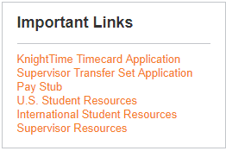
Resources on InfoCenter
Employment Tab -> Student Employment
Important Links Section
KnightTime Timecard Application (for students)
Supervisor Transfer Set Application (for supervisors)
Supervisor Resources -> Instruction Guides

Slide 5
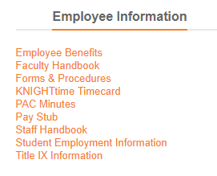
Resources on InfoCenter
Employment Tab
Employee Information Section
KnightTime Timecard Application (for hourly employees)
Forms & Procedures -> Instruction Guides

Slide 6
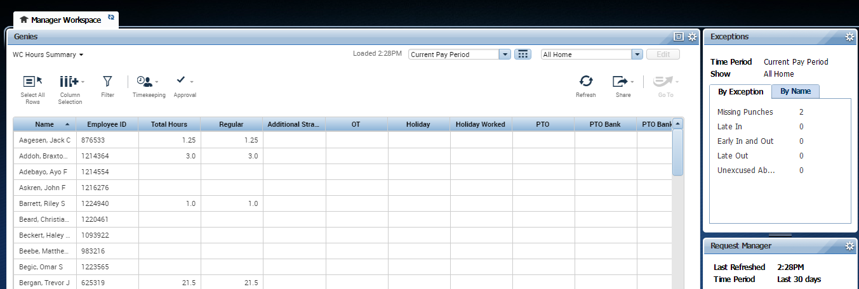
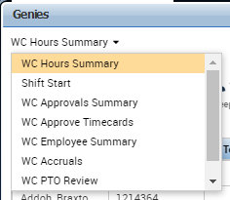
Home Screen & Genies

Slide 7
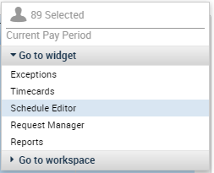
Home Screen & Genies

Slide 8
Home Screen & Genies

Slide 9
Best Practices: Reviewing Work Hours
Check for these items:
Purple Punches
Transfer Sets are populated for each set of punches
Missing Punches
Payroll Categories (They should be consistently CE, FWS, or CS for academic year work hours, not CES.)
Total Work Hours Per Week (for Staff).

Slide 10
Best Practices: Reviewing Work Hours
What is wrong with this picture?

Slide 11
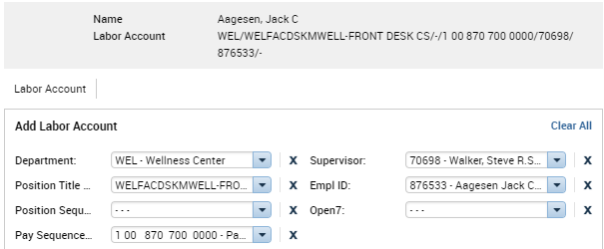
Best Practices: Transfer Sets
When entering a transfer set, utilize the “Search” function:
Make sure all 7 fields are completed, including fields 3 and 7 which are dashes.

Slide 12
Best Practices: Transfer Sets
Verify the 7 correct fields of an employee’s transfer set by logging into the InfoCenter and using the “Supervisor Transfer Set” application on the Student Employment webpage.

Slide 13
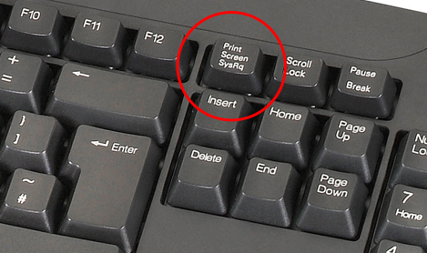
Best Practices: Transfer Sets
If you receive an error indicating that you cannot save a transfer set you entered, take a screen shot and email it to the Student Employment Office or Human Resources.
To take a screen shot:
Alt key + Print Screen key (PrtScn) and then paste into the body of the email using Ctrl key + V
OR Utilize the Snipping tool

Slide 14
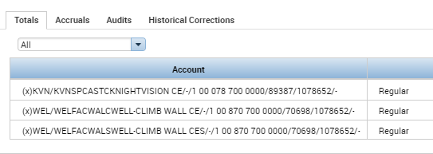
Best Practices: Transfer Sets
Multiple lines for one position in the totals section indicates an issue with a transfer set:
Inconsistencies in transfer sets causes errors when the data is exported for payroll.

Slide 15
Best Practices: Approvals & Deadlines
Student timecard approvals are due by noon on the 1st business day of each month.
Staff timecard approvals are due the 3rd business day of each month.
Verify approvals by looking on individual employees’ timecards under the “Audit” tab.

Slide 16
Best Practices: Delegations
Delegation: Allows another “manager” to view your employees and act (correct timecard errors/approve) on your behalf.
Benefits of Delegations:
Temporary Coverage
Cross-Trained Managers
To set-up a delegation, contact the Student Employment Office or Human Resources Office.

Slide 17
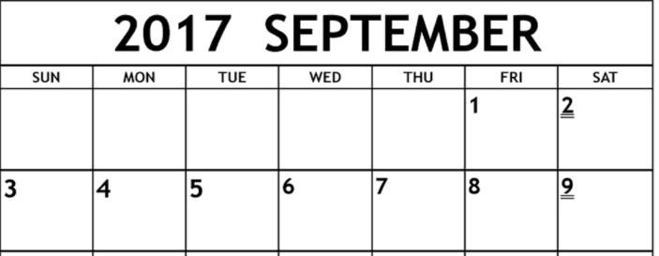
Best Practices: Requesting & Reviewing Time Off
Requesting Multiple Days of PTO
Do not request a date range that includes a weekend.
i.e. Let’s say you took September 1st and 4th as PTO. Enter two time off requests – one for the 1st and one for the 4th.

Slide 18
Best Practices: Requesting & Reviewing Time Off
Requesting Hours of PTO
Enter total hours per day, not for the duration you will be gone.
i.e. Let’s say you took September 4th and 5th as PTO. Enter one time off request – September 4th through the 5th for 7.75 hours, not 15.50 hours. If you enter 15.5 hours, it will take 15.5 hour each day.

Slide 19
Best Practices: Requesting & Reviewing Time Off
Total Hours Per Week
Hourly employees must ensure that they have met their total work hours each week. Supervisors should verify this when reviewing their timecards.
PTO
Supervisors may input PTO on employee timecards prior to approving timecards at the month end. This will help expedite the payroll process and assist supervisors with meeting the approval deadline.

Slide 20
Resources
Student Employee Supervisor Handouts
InfoCenter > Employment > Student Employment > Supervisor Resources > KnightTime Resources
Contact: Abbie Raum, ext. 8350
Faculty & Staff Supervisor Handouts
InfoCenter > Employment > Forms & Procedures > KnightTime Resources
Contact: Erica Sadler, ext. 8766

